Slide 1
Overview - CI/CD Pipeline in AWS

Slide 2
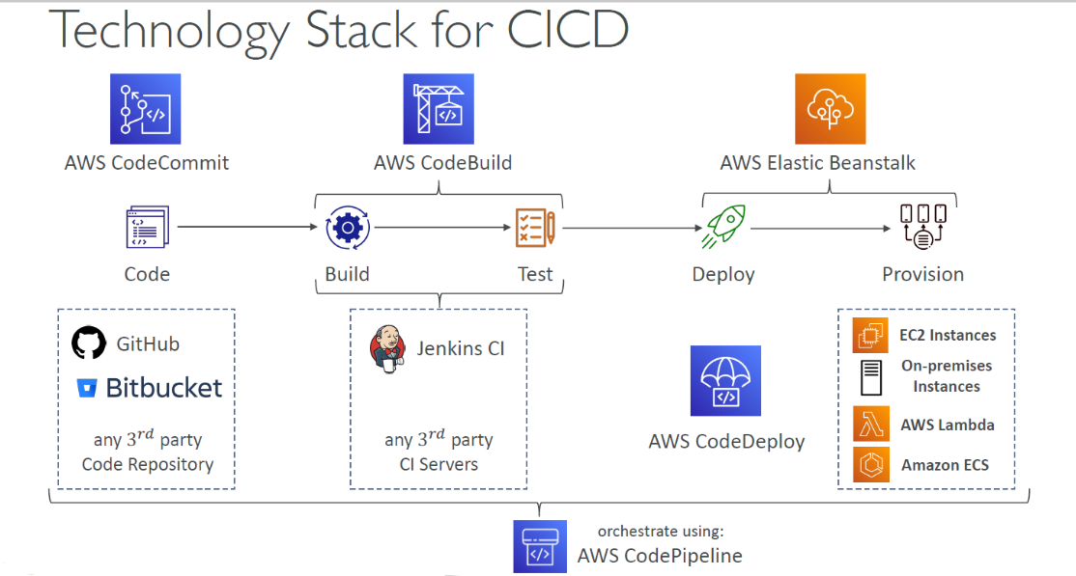
Integration and Deployments: AWS
AWS Key Components for CICD:
AWS Code Commit -> Code repository like GIT, Big Bucket and other source control management tools.
AWS Code Build -> Jenkins and other CI tools for build and test
AWS Code Deploy -> Deploy the application/changes in EC2 instances, Lambda, ECS, Beanstalk
AWS Code Pipeline -> Integrate the above service and automate the build, test, deploy.
Code Artifacts ->Store, publish and share softwere packages

Slide 3

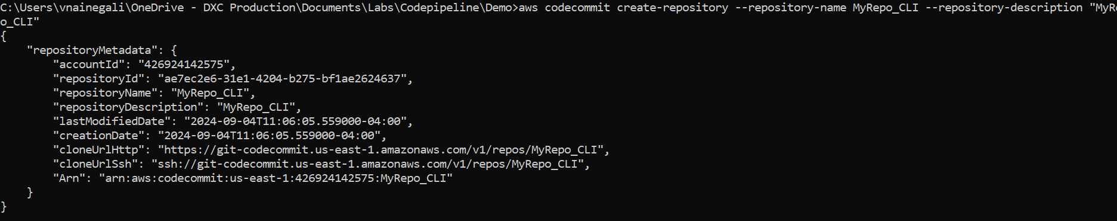
AWS Code Commit:
Note: AWS announced that it will stop adding new features to AWS CodeCommit and will no longer onboard new customers be starting onwards - July 25, 2024
Version control tool within AWS for code repository, inherit the similar future as GIT.
It synchronizes to our local machines similar to the GIT and operate with similar set of commands as GIT.
Encryption: Encrypted in transit using SSH or HTTPS and KMS at rest.
Authentications: HTTPS – with AWS CLI Credential helper or Git Credentials for IAM user OR SSH Keys from IAM console.
Authorizations: IAM policies being used manage users/roles permissions.
This can be operated in many ways like GIT, by having a required permissions in place.
Few steps to add the code to Code-commit via Console or GIT or AWS-CLI
AWS Console: Create Repo via browser. Add files, update, delete the files in UI.
AWS CLI Commands: By calling Codecommit API :https://docs.aws.amazon.com/cli/latest/reference/codecommit/
Example: aws codecommit create-repository --repository-name MyRepo_CLI --repository-description "MyRepo_CLI"

Slide 4

AWS Code Commit: (Not applicable for new customers/accounts):
GIT Client – It follows two types of connectivity: https://docs.aws.amazon.com/codecommit/latest/userguide/setting-up.html
For HTTPS users using Git credentials
Configuration for IAM user to access codecommit with permissions – AWSCodeCommitPowerUse
Install GIT latest versions
GIT credential generations for IAM user
Clone the code-commit repository
git clone https://git-codecommit.us-east-1.amazonaws.com/v1/repos/MyDemoRepo my-demo-repo (change the region as needed) –
For HTTPS connections with git-remote-codecommit
Configuration for IAM user to access codecommit with permissions – AWSCodeCommitPowerUse
AWSCLI, Python install/Configuration.
Install git-remote-codecommit: pip install git-remote-codecommit
Clone the code-commit repository
git clone codecommit://MyDemoRepo my-demo-repo
via AWSCLI profile
git clone codecommit://CodeCommitProfile@MyDemoRepo my-demo-repo

Slide 5
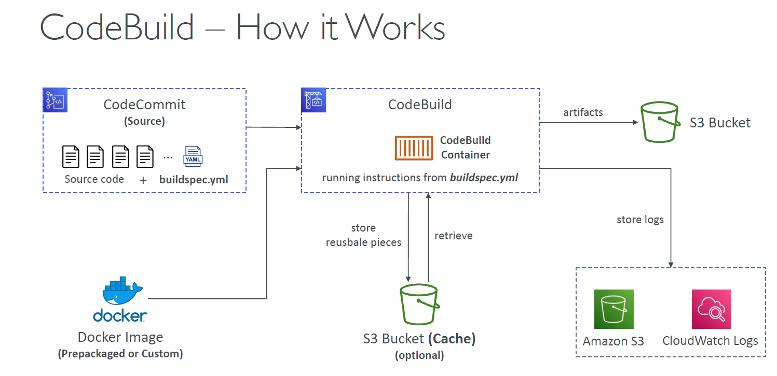
AWS CodeBuild:
AWS Managed continuous integration service. (Alternative to Jenkins)
Encryption: Integrated with KMS for build artifacts. AWSCodeBuildDeveloperAccess will have all other integrated access to service to do the required actions with code build. (For S3, SSM, SNS, Cloudwatch logs etc)
Charged based on time it takes to complete the build.
Can create prepackaged docker images or we can create our own.
Integrate with most of the AWS services like ECR, S3, cloudwatch, SNS etc.
Source: Pull the code from CodeCommit, GitHub, S3
Need to have buildspec.yml file containing all build instructions in the primary folder of repository. – root of the code in hierarchy.
Supports for environments coded in Java, Ruby, Python, PHP, Node.js, Go, .NET Core

Slide 6
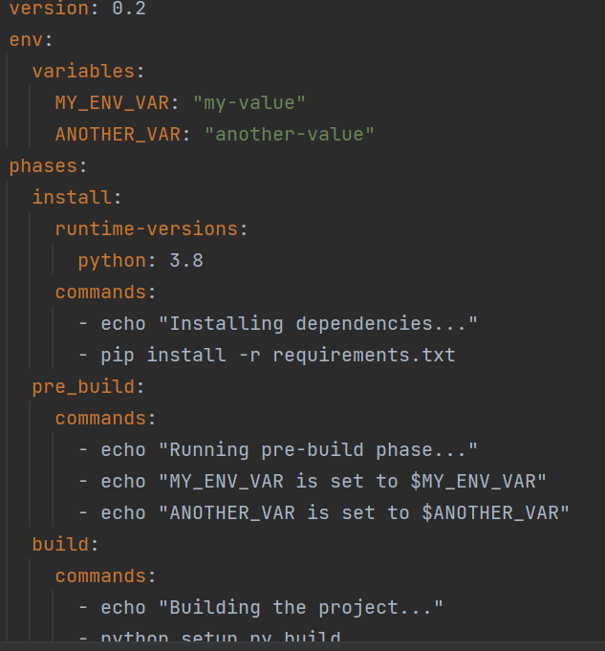
AWS CodeBuild:
buildspec.yml: Ref: https://docs.aws.amazon.com/codebuild/latest/userguide/build-spec-ref.html#build-spec-ref-example
buildspec.yml file should be at root of our code. (not in subfolder etc)
Critical sections in this file
env: – define the environment variable
phases: – specific commands to run.
install -> Install dependencies for build.
pre_build -> Commands to execute before build.
build -> Actual build commands.
post_build -> finishing post build activities.
artifacts: Artifacts to upload on s3
cache: Files to cache to speed up the future build – usually store in s3

Slide 7
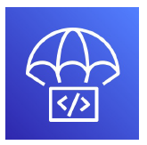
AWS Code Deploy:
Automates the deployment of code or new version of the code in the EC2, On-premises servers, Lambda, ECS
Provides automatic rollback and gradual deployment methods as per the need.
appspec.yml file would help to define how deployment should happen from CodeDeploy into the target infrastructure.
Support the different types of automatic deployment type and different deployment settings based on the compute platform (EC2/On-premises, ECS, Lambda as examples mentioned below)
EC2/On-premises Platform
AllAtOnce: most downtime
HalfAtATime: reduced capacity by 50%
OneAtATime: slowest, mostly no downtime in case of autoscaling
Lambda Platform
AllAtOnce: most downtime
LamdaLinear10PercentEveryXMinutes: grow traffic every X(1,2,3,10) minutes until 100%
LamdaCanary10PercentEveryXMinutes grow 10% traffic for X(5,10,15,30) minutes then 100% after that.
ECS Platform
AllAtOnce: most downtime
ECSLinear10PercentEveryXMinutes: grow traffic every X(1,3) minutes until 100%
LamdaCanary10PercentEveryXMinutes: grow 10% traffic for X(5,15) minutes then 100% after that.

Slide 8
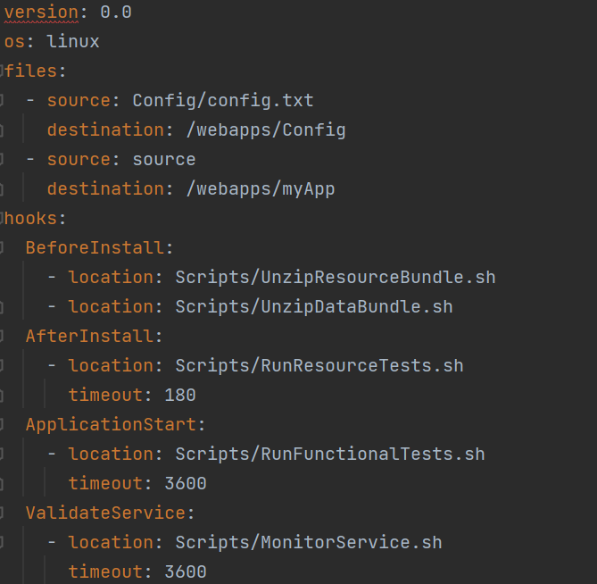
AWS Code Deploy:
appspec.yml: https://docs.aws.amazon.com/codedeploy/latest/userguide/application-specification-files.html
https://docs.aws.amazon.com/codedeploy/latest/userguide/reference-appspec-file-example.html
In appsepc.yml has the lifecycle hooks/deployment life cycle/stages to be defined in it.
ApplicationStop: Added this before new version is downloaded. Stop the application and remove the packages.
DownloadBundle: CodeDeploy agent copies the application revision files to a temporary location
BeforeInstall: Preinstall work in target compute system.
Install: CodeDeploy agent copies the revision files from the temporary to the destination folder
AfterInstall: Configure your application.
ApplicationStart: Restart the service whish stopped at stop activity.
ValidateService: It is used to verify the deployment was completed successfully.
Additional stages can be added to debug the failures.
BeforeBlockTraffic
BlockTraffic
AfterBlockTraffic
BeforeAllowTraffic
AllowTraffic
AfterAllowTraffic

Slide 9

AWS Code Pipeline:
Visual workflow to orchestrate the CICD in AWS
Integrates Source – Build – Test and Deployment stages for software releases.
Source: CodeCommit, ECR, S3, GitHub, Bitbucket
Build: Codebuild, Jenkins, 3rd Party tools
Test: Codebuild, 3rd Party tools
Deploy: Codedeploy, CloudFormation, Elastic Beanstalk
Manual approval of hold can be added at different stage of pipeline.
Add failure event triggers for failed pipelines and logs captured in CloudWatch events/Event bridge.
Creates Artifacts and place into the S3.

Slide 10
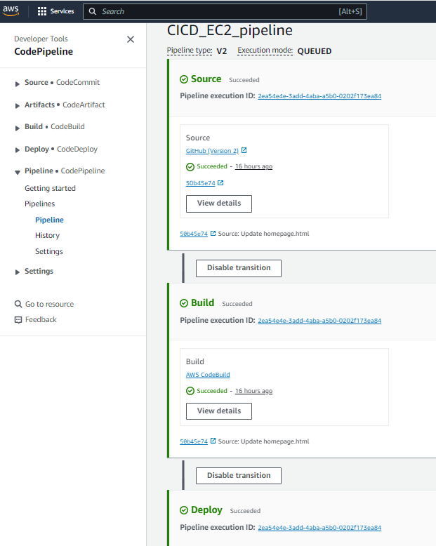
Pre-req: Pipeline using Build, Deploy on EC2:
IAM Roles: EC2, Codedeploy and Codebuild
EC2: (S3, Codedeploy, ECR)
AmazonEC2ContainerRegistryFullAccess
AmazonS3FullAccess
AWSCodeDeployFullAccess.
CodeDeploy: (for EC2)
AmazonEC2RoleforAWSCodeDeploy
AWSCodeDeployFullAccess
Codebuild: (for ECR)
AmazonEC2ContainerRegistryFullAccess
EC2 Preparation:
Launch EC2 instance.
Attache securitygroup with Inbound traffic any.
Attach IAM role for EC2
Install code deploy agent
Install nginx
Update proxy
Restart nginx
sudo apt update sudo apt install ruby-full sudo apt install wget cd /home/ubuntu
wget https://aws-codedeploy-us-east-1.s3.us-east-1.amazonaws.com/latest/install
chmod +x ./install sudo ./install auto
sudo service codedeploy-agent status
sudo apt install nginx
sudo vim /etc/nginx/sites- available/default
Update location as below:
proxy_pass http://127.0.0.1:5000;
sudo systemctl restart nginx
Create the application code and add to repo.
Create ECR Repository for Images.
Configure/define Code Build project and buildspec.yml and attach the role
Configure/define Codedeploy, deploymentgroup
deployment using appspec.yml file and
attach the role.
Configure CodePipeline project – using GIT connection as source, Codebuild and Codedeploy details with default service role.

Slide 11
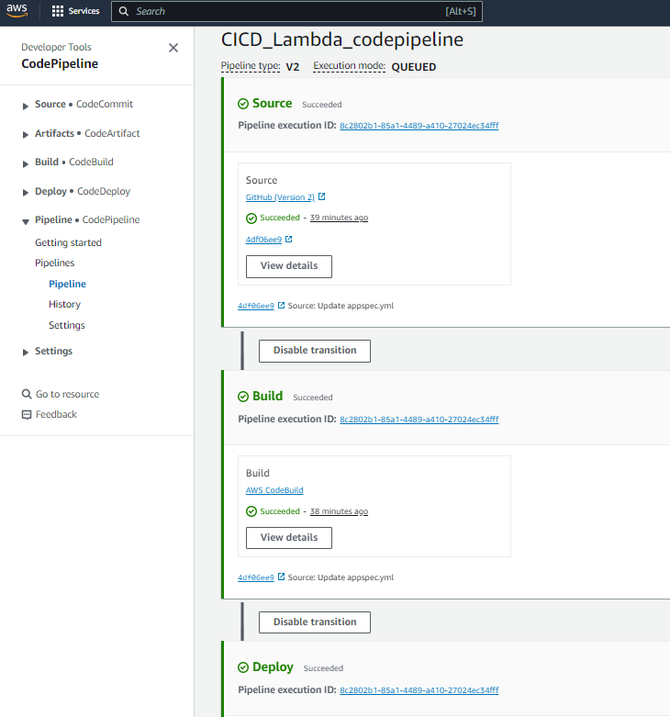
Pre-req: Pipeline using Build, Deploy on Lambda:
IAM Roles: Codedeploy, Codebuild
CodeDeploy: (Lambda, Codedeploy)
AmazonS3FullAccess
AWSCodeDeployRoleForLambda
add lambda access
Codebuild:
Default service role lambda actions as below)
"Action":
["lambda:AddPermission", "lambda:RemovePermission", "lambda:CreateAlias",
"lambda:UpdateAlias",
"lambda:DeleteAlias",
"lambda:GetFunction", "lambda:UpdateFunctionCode", "lambda:UpdateFunctionConfiguration", "lambda:PutFunctionConcurrency", "lambda:DeleteFunctionConcurrency", "lambda:PublishVersion“]
Create the Lambda Function/Application code.
Define the alias via Console or scripts
Configure/define Code Build project and buildspec.yml
Configure/define Code Build project and buildspec.yml and attach the role
Configure/define Codedeploy, deploymentgroup
deployment using appspec.yml file and
attach the role.

Slide 12
Thank You All!!
“Change is the end result of true learning”
Happy Learning !!

